Slide 1

Mean Forum - MongoDB
An introduction to MongoDB by Prinay Panday

Slide 2
Course Content
What is MongoDB?
Setup and installation of Mongo
Basic Installation
MongoDB as a service
Using the MongoDB shell
Starting the shell
Simple commands
CRUD in Mongo
Creating your first database
Creating a collection
Inserting
Reading from a collection
Updating a collection
Deleting in a collection
Scripting in Mongo Shell
Available GUI clients

Slide 3
What is MongoDB?
MongoDB is an open source, document-oriented database designed with both scalability and developer agility in mind. Instead of storing your data in tables and rows as you would with a relational database, in MongoDB you store JSON-like documents with dynamic schemas. MongoDB refers to this format as BSON which stands for “Binary JSON”.
The maximum size of any document in MongoDB is 16MB.

Slide 4
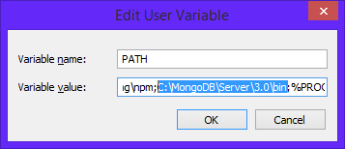
Setup and Installation – Basic Installation
Run the mongo installer (mongodb-win32-x86_64-3.2.3-signed.msi)
Run through the guided installation and take note of the installation directory. For this course we will install Mongo at C:\mongodb
Mongo requires a data directory to store all data. Create the following directory C:\data\db
Add mongo to your path variable. This will allow you to run mongo from a terminal anywhere on your PC.

Slide 5
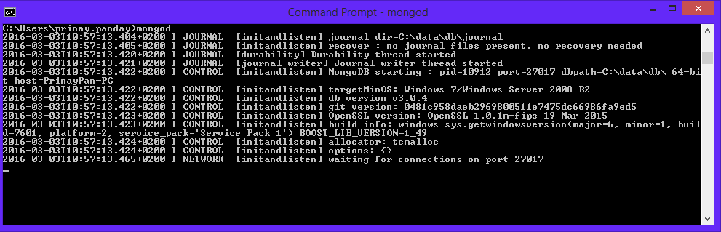
Setup and Installation
Test that mongo is setup correctly by opening a command prompt and run mongod.
mongod.exe starts the main MongoDB process. By default mongo runs on port 27017

Slide 6
Setup and Installation – Mongo as a service
To avoid running mongod all the time it is possible to install MongoDB as a windows service.
Create the following directory c:\data\log
Create a config file called “mongod.cfg” in C:\Mongodb\
Enter the following in the config file:
systemLog:
destination: file
path: c:\data\log\mongod.log
storage:
dbPath: c:\data\db

Slide 7
Setup and Installation – Mongo as a service
4. Open a command prompt with admin privileges and run the following:
"C:\mongodb\bin\mongod.exe" --config "C:\mongodb\mongod.cfg" –install
5. Start the MongoDB service by running:
net start MongoDB
You should now see MongoDB listed under your services
With MongoDB installed as a service you won’t need to run mongod.exe anymore.

Slide 8
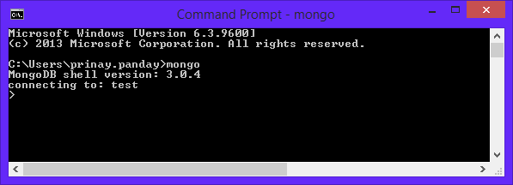
Using the MongoDB shell – Start up
The mongo shell is an interactive JavaScript interface to MongoDB and is a component of the MongoDB package. You can use the mongo shell to interact your database and perform administrative operations.
To start up the mongo shell open a command prompt and simply type mongo

Slide 9
Using the MongoDB shell – Simple Commands
help – list of available commands
show dbs – lists available databases
use <db_name> – switches to the specified database
show collections – lists the collections in the current database
db.<collection_name>.find() – lists object in specified collection (Basic select)
db.<collection_name>.insert({object}) – inserts a new document into a collection
db.<collection_name>.count() – returns the number of objects in the collection
You can find a full list of collection methods by visiting https://docs.mongodb.org/manual/reference/method/js-collection/

Slide 10
CRUD in MongoDB
In the following section we will perform basic to intermediate CRUD operations on a Mongo database. We will use the Mongo shell to perform all of our operations.
Ensure that your Mongo service is started and that you have the Mongo shell opened in a command prompt.

Slide 11
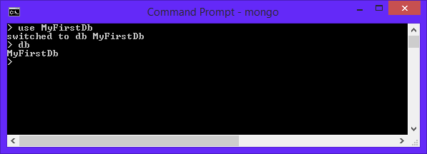
CRUD in MongoDB – Creating your first DB
Creating a database in Mongo is extremely simply and quick.
Remember the command use that would switch to a database that you wanted to use? Well this command also creates a database for you. If Mongo can not find a database with the specified name it will automatically create a database with that name for you.
Lets create a database for our blog called “MyFirstDb”. To check if you are using the correct database simply run db.

Slide 12
CRUD in MongoDB – Creating a collection
A collection may store a number of documents. A collection is like a table in a relational database.
A collection may store documents that do not necessarily have the same structure. This is because MongoDB is a schema-free database. In MongoDB you do not need to define a column and its datatype as you would in a relational database.
There are two ways to create a collection in MongoDB
Implicitly by just referencing a collection name: db.<collection>.insert()
Explicitly if you require a collection with specific options: db.createCollection(<name>, {options})

Slide 13
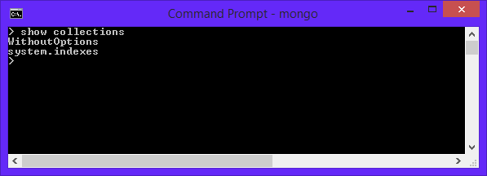
CRUD in MongoDB – Creating a collection
Implicitly Created Collection:
Run db.WithoutOptions.insert({test: “No Options”}) (We’ll cover inserts later on)
Now if you run show collections you will see the newly created collection

Slide 14
CRUD in MongoDB – Creating a collection
Creating a collection with options:
Lets say we wanted to provide the maximum size in bytes that a collection could reach and the maximum of documents that can be stored in a collection. To do this we need to set the max and size options. NB: size takes precedence over max
db.createCollection(“WithOptions”, { capped : true, size: 2000000, max : 10 } )
This creates a collection called WithOptions that has a maximum size of 2MB and can store a maximum of 10 documents. MongoDB will start removing older documents if the size limit is reached before the max documents limit.

Slide 15
CRUD in MongoDB – Inserting
db.collection.insert({document})
Inserting in mongo is straight forward. The insert method takes a document or an array of documents as a parameter.
If the collection does not exist it will automatically be created by the insert method.
Example:
db.entelect.insert({name:"Prinay",surname:"Panday"})
db.entelect.insert([{name:”Prinay”, surname:”Panday”}, {name:”test”, surname:”test”}])

Slide 16
CRUD in MongoDB – Reading from a collection
db.collection.find(query,projection)
.find() selects documents in a collection and returns a cursor to the selected documents. Leaving the query blank will return all documents in the collection.
query – Selection criteria
projection – Specifies the fields to return. Leave empty to return all fields
Example:
db.entelect.find({name:”Prinay”})
Adding .pretty() to the end of the find will print the data in an indented format

Slide 17
CRUD in MongoDB – Updating a collection
db.collection.update(query, update, options)
The update method modifies an existing document(s) in a collection. Update allows you to modify specific fields on a document(s) or replace the document entirely depending on the parameters you provide it with.
Update Paramaters:
query – Selection criteria for the update
update – The modifications to apply
options – Set of parameters that specify the behaviour of the update
The two most important options are upsert and multi

Slide 18
CRUD in MongoDB – Updating a collection
upsert: If set to true, a new document will be created if no document is found according to the query criteria. By default this value is false and a new document will NOT be created if the query criteria is not matched.
multi: If set to true, multiple documents that match the query criteria will be updated. By default this value is false and only ONE document will be updated.
Example:
db.entelect.update({ name: “Batman" }, { name: “Batman", position: “Value added services” }, { upsert: true })
In the above example upsert is set to true. This means that if Batman doesn’t already work for Entelect, then now he will.

Slide 19
CRUD in MongoDB – Deleting in a collection
db.collection.remove()
The remove method removes documents from a collection. You may use this method to remove all documents in a collection, all documents that match a criteria or remove just a single document.
Examples:
db.entelect.remove() – Removes all documents from the collection
db.entelect.remove({name:”Prinay”}) – Removes all documents with the name “Prinay”
db.entelect.remove({name:”Prinay”}, 1) – Removes a single document with the name “Prinay”

Slide 20
Scripting in Mongo Shell
As mentioned earlier the Mongo Shell runs on JavaScript therefore you may be able to do some scripting in the shell using ordinary JavaScript.
You may also create .js files for example lets create a js file that will retrieve all documents from a collection and print it to the screen. (test.js)
var people = db.entelect.find();
people.forEach(function(person) {
printjson(person);
});
To run this script simply execute mongo <db_name> test.js
This is a simple example but scripting can become really powerfull especially if you have to run the same commands over and over again.

